Slide 1

AN ANDROID APP ON “PLACEMENT FORUM”
Presented to you by :
Pragya Gupta - T150054427
Guided by :
Professor Yogesh Handge

Slide 2
MOTIVATION
Taking up this project was primarily an interest in undertaking a challenging project on constructing an android app : “A placement forum”. This goal was set up because it’s difficult to stay updated about the training and placement activities and such that with this development, people can carry out their career goals in a planned systematic way.
Most students don’t have the prime courage to ‘approach’ someone, or either they don’t have a base company target goal set in mind.
A better way to ease the hassle, is making an free and easy effective application ‘PLACEPICT’ for the the PICT family.
With the help of this app, communication shall be user-friendly and established amongst many peers, staff, and amongst various other beings.

Slide 3
SURVEY
Studied Quora app and website, as our app is similar to theirs.
Verified with staff and peers about the need for this app.
Asked TnP cell if they need an app for their fruitful use.
Learnt about our target audience i.e., students, staff and alumnis.
Analyze and report on various activities carried out by the training and placement cell.
Noted the advantages and disadvantages of our app, whilst settling for it.

Slide 4
REQUIREMENTS GATHERING
Functional Requirements :
Allow juniors to post questions and seniors to answer the questions.
Platform for sharing of interview experiences.
Keeps the user upto date with the training and placement activities.
Non-Functional Requirements :
Provides an online guide-system.
Betterment of placement statistics, of the college.
Provides authentic and appropriate solution for all types of queries.

Slide 5
REQUIREMENTS ANALYSIS
Display of all the queries in the form of posts, and answers in the form of comments.
Searching must be user-friendly.
Owner should be able to keep track of the activities over the app.
Updation of the company criteria and placement activities should be appropriate and easy for the owner.
Linking from app to various websites should be effective.
User Interface should follow all the golden rules of UI/UX design.

Slide 6
PROBLEM STATEMENT
To construct :-
An Android App.
The app is based on a platform of sharing experiences, queries, having debates and also related to the companies visiting our college.
It should be more like a forum, where the people can ask their queries, and whoever has knowledge or experience regarding them can answer.
The training and placement activities that are to take place/taking place in the college shall be updated on this app as well.
Some short references to help freshers get an idea on ‘how and what’ to target for their goals.

Slide 7
ARCHITECTURE
DIAGRAM
UPDATE/DELETE POST
ADD NEW POST fragment
UPLOAD POST PAGE
COMMENT ON POST
ON CLICK
COMPANIES UPDATE
PROFILE
fragment
POST
PLACEMENT REPORT
HOME PAGE
ABOUT US fragment
OTHER REFERENCES
LOGIN PAGE
MAIN
SAVE USER PAGE
CONTACT US fragment
REGISTER
PAGE
SHARE fragment
LOGOUT
fragment

Slide 8

RESOURCES USED
Software Resources :
Android Studio.
JRE(Java Runtime Environment) and Android SDK(Software Development Kit).
High speed internet connection.
Google Firebase.
Hardware Resources:
Data cable for testing and installing.
Android Mobile phone.
Laptop.

Slide 9
API USED
Frontend : Android ( Java, XML).
Backend :
GOOGLE FIREBASE Authentication, Real-time Database, Storage.
b) Glide - For Images.
Server Used : Apache Server.
Supported Android Versions : Jelly Bean to Oreo.

Slide 10
HIGH LEVEL DESIGN, USED CASES
PLACEMENT
APP
NORMALIZE
STATS
LOGIN
APP SERVER
<<include>>
DATABASE
<<include>>
SIGN
UP
QUERIES
<<include>>
STAY
UPDATED

Slide 11
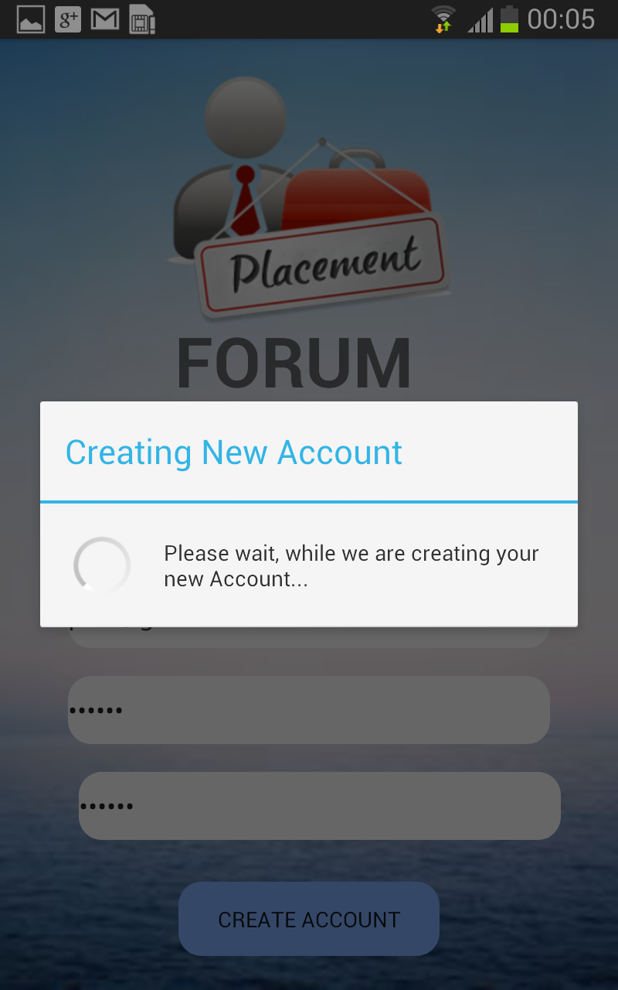

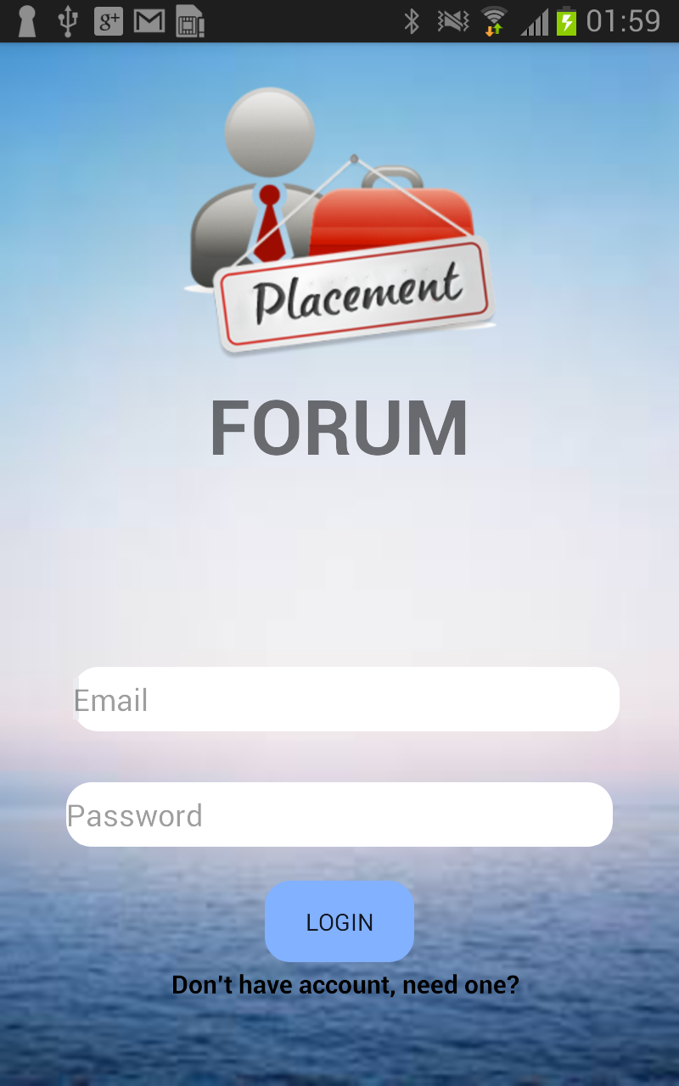
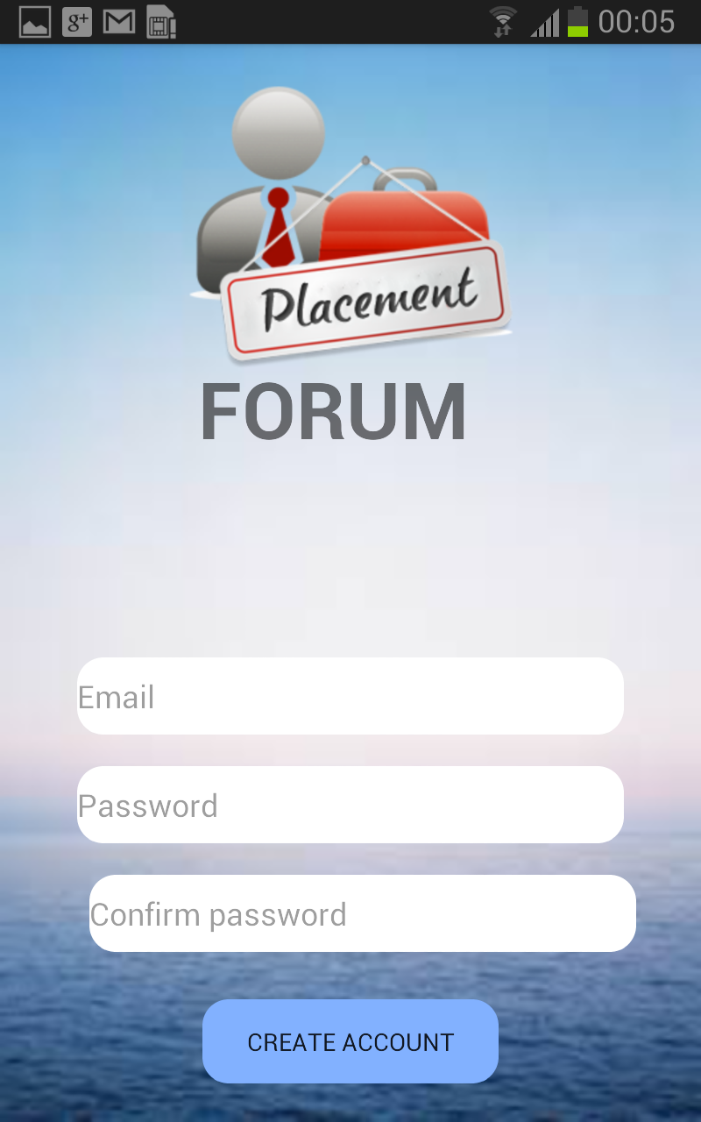
SCREENSHOT RESULTS/ANALYSIS
Sign up Activity:
For a new user, he/she has to signup first. This is done by entering his/her username, password, department and occupation which is the year in which he/she is studying currently (for college student) and ‘alumni’ if he/she is an alumni of the college. This username would be associated with one user and anything that the user posts would be by this username.
Login Activity:
This use case describes how any student/alumni can login using this app only if they already own an account.They need to submit they username and password to gain access to their account.

Slide 12
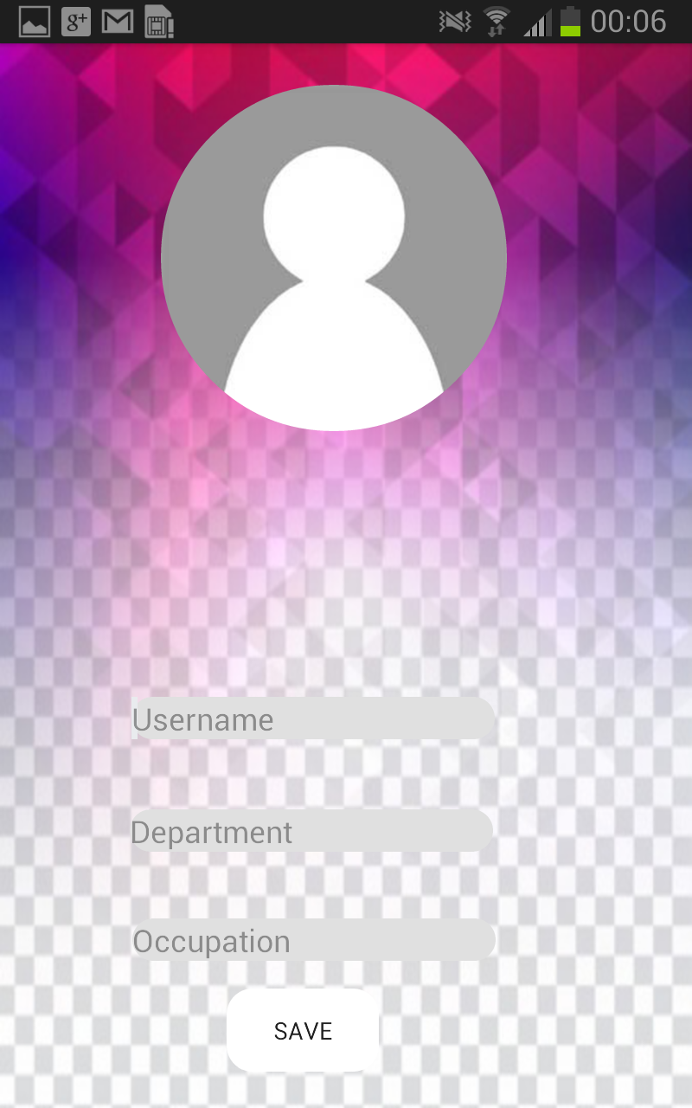
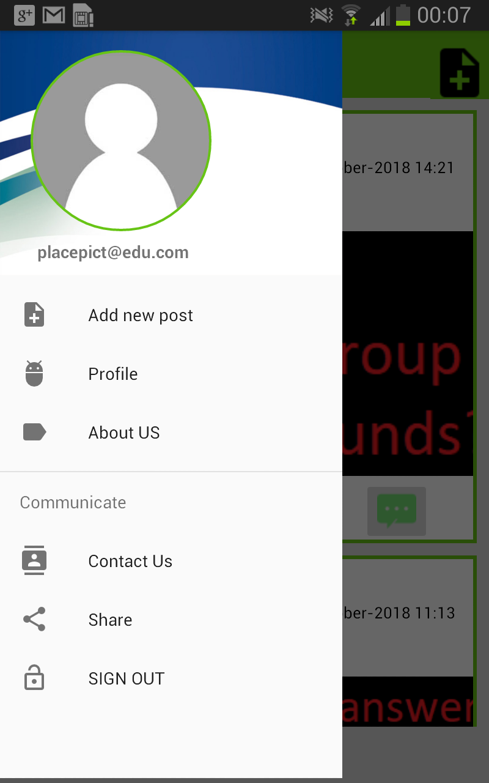
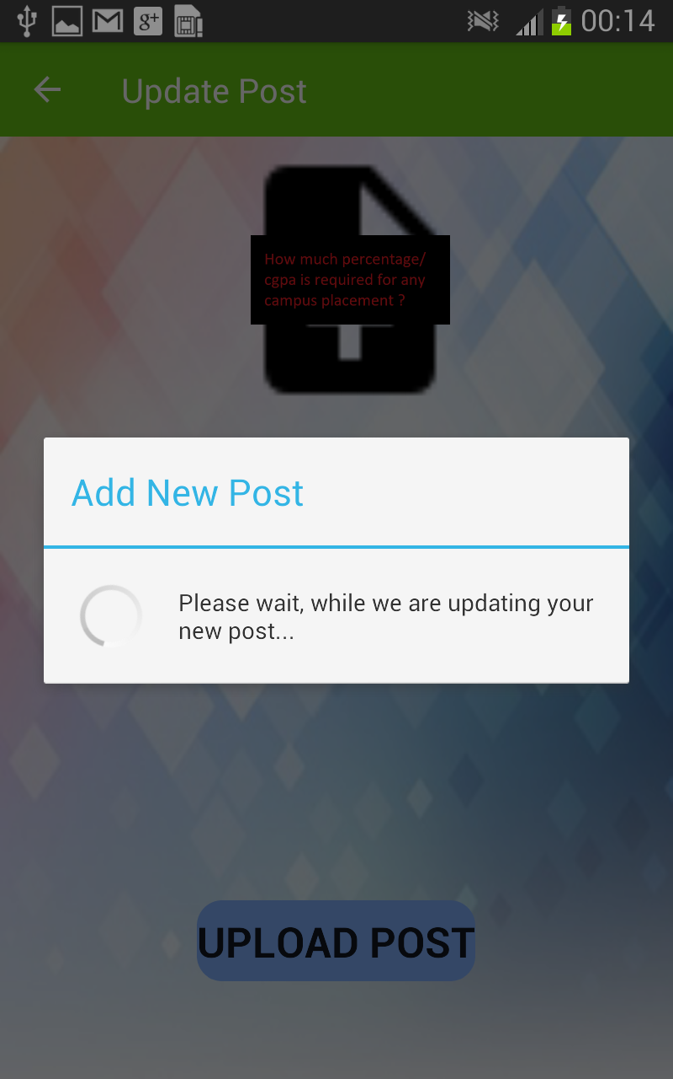
Setup Activity:
This use case describes how any student/alumni define their own credentials and identity for future recognition.
Navigation Drawer:
This gives access to functionalities such as ‘ask question’, ‘profile’, ‘about us’, ‘contact us’, ‘share’ and logout.
Upload Activity:
Helps post a new question/post to our feed.

Slide 13
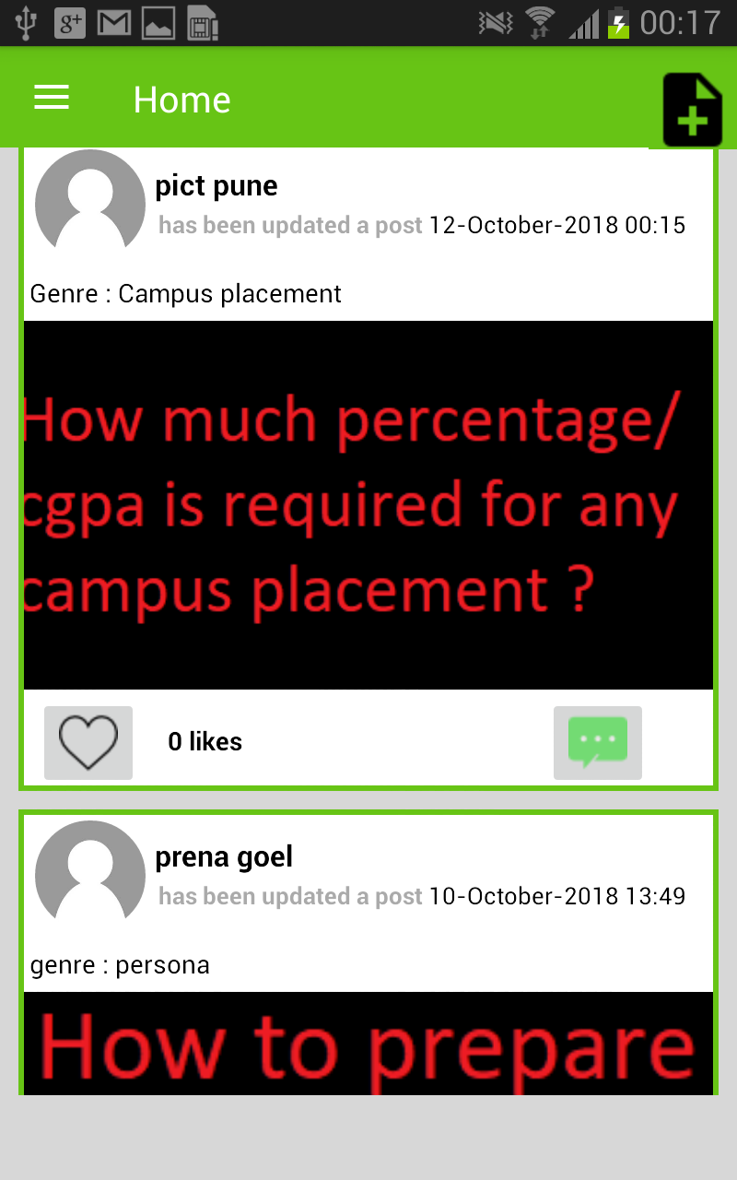
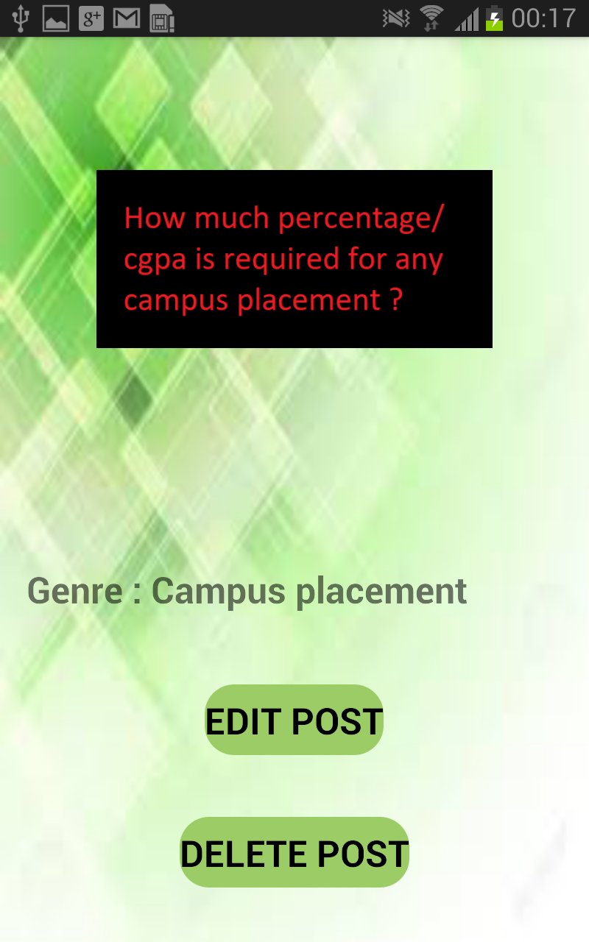
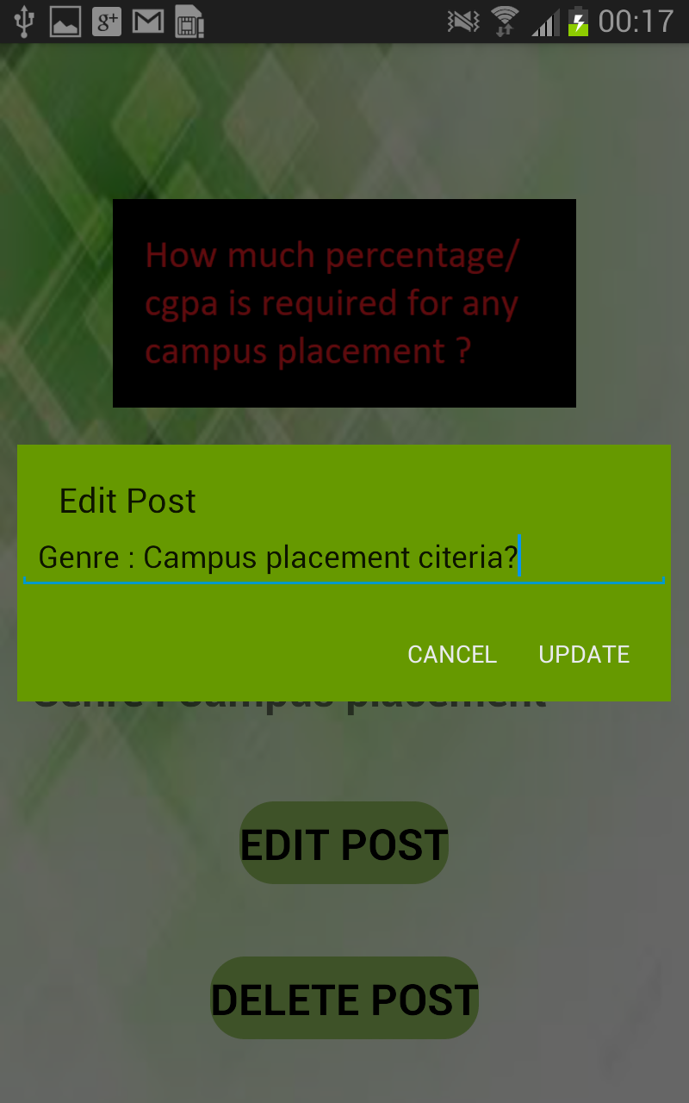
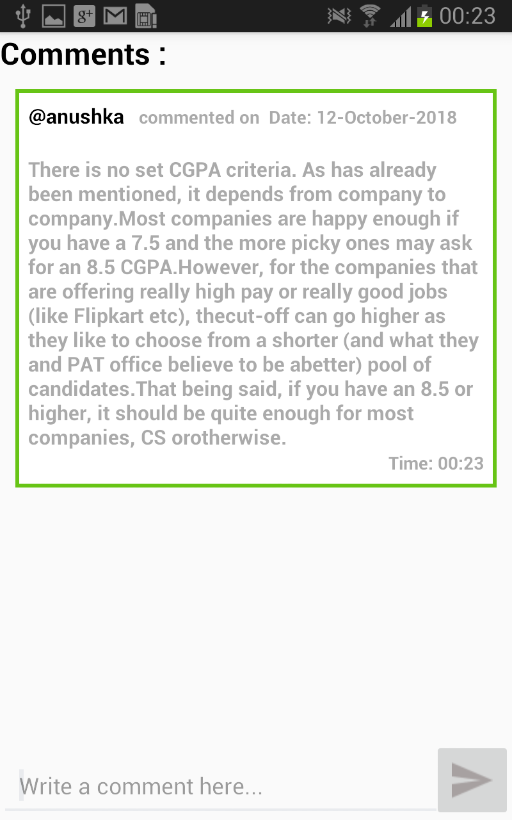
Home Module:
1)Here is our home feed, where the discussion and communication takes place of various topics related to training and placement activities.
2) We can upload a new post, but the description must be defined clearly to give an insight to as what the post is about.
3) We can also click on a post to edit/ delete it, but it can only be done from the owners account.
4) A user-friendly and interactive environment is established.

Slide 14
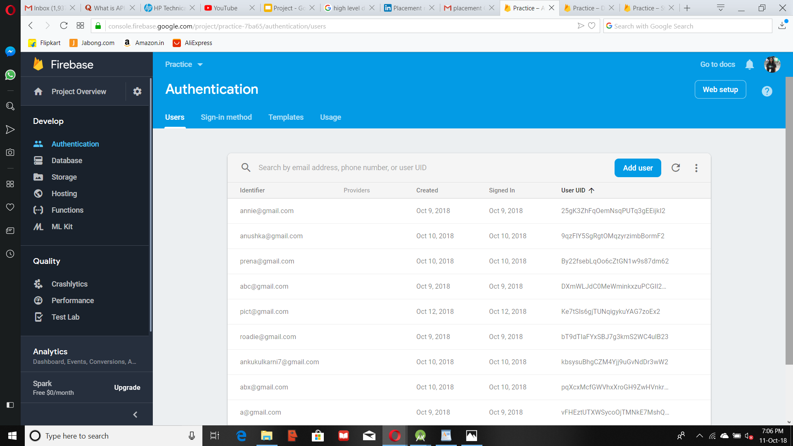
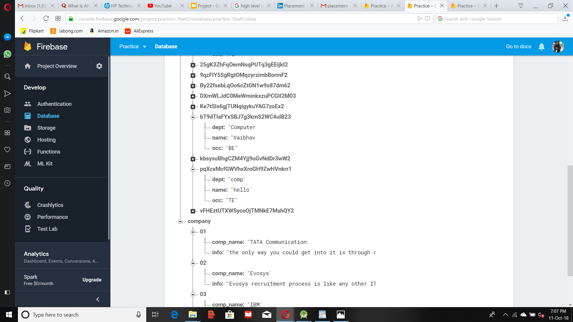
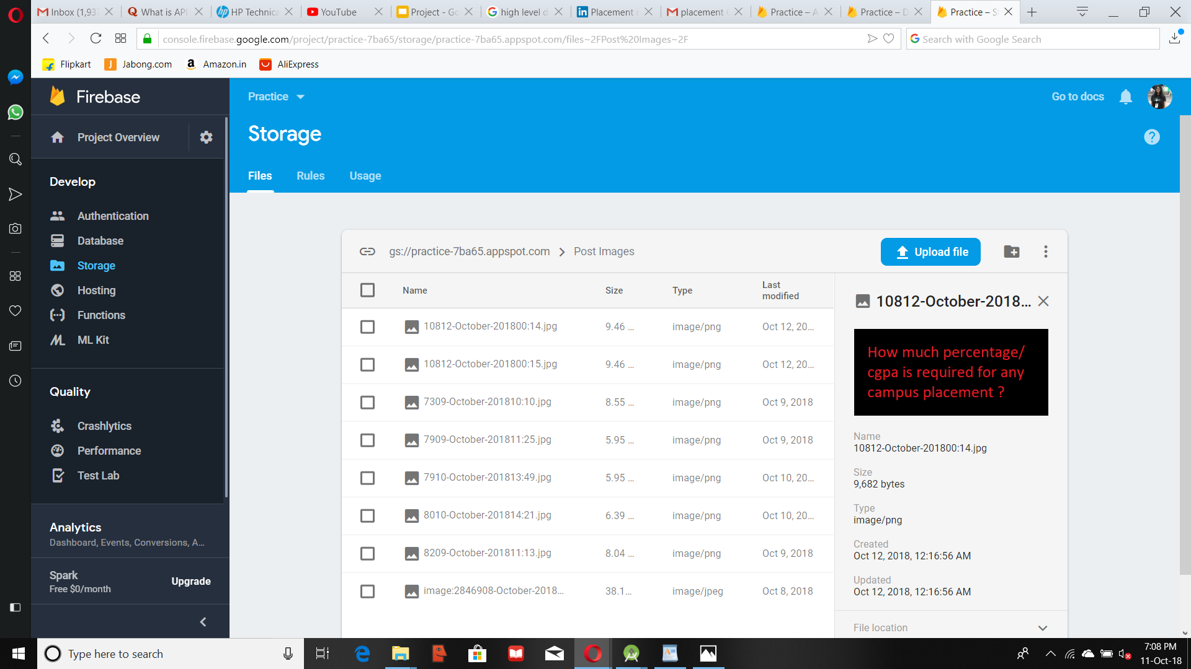
Firebase Snapshots:
Whenever we perform some actions, those actions are recorded in the form of JSON objects and stored on the database. The pictures are stored in a library i.e., glide, which then can be used as an imageloader.

Slide 15

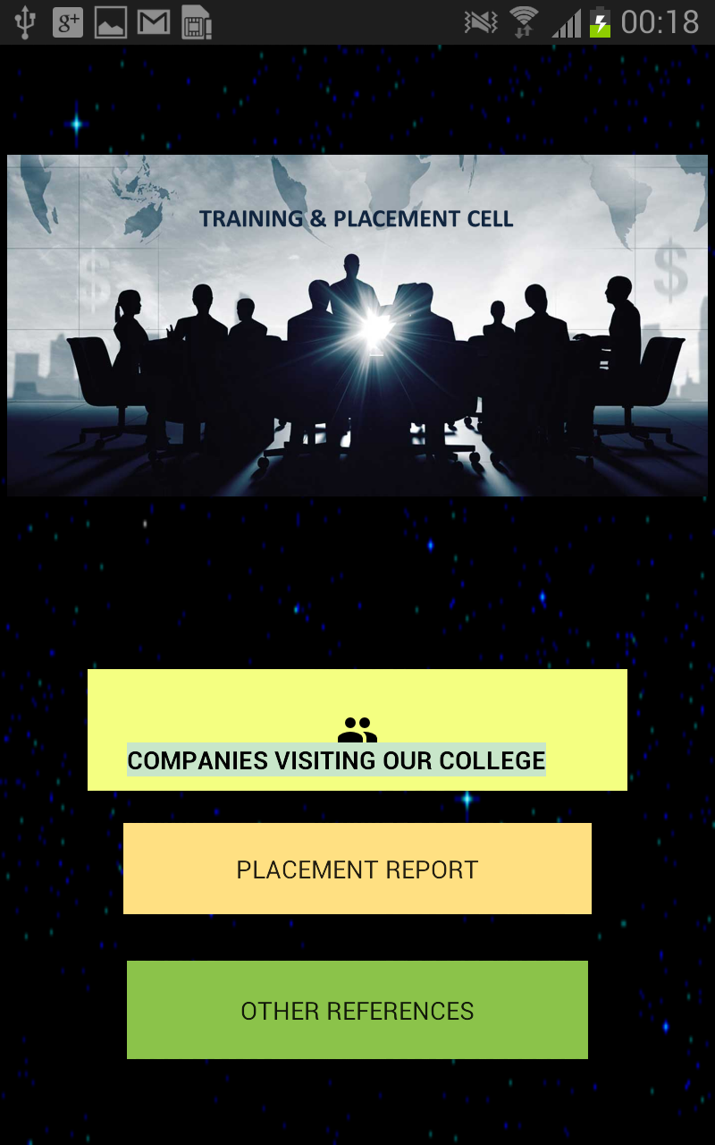

Profile Module:
This fragment involves the use of event handling, where we navigate towards different activities by just clicking on buttons.
Here, we can get the insight towards the various activities or necessities that are being carried out by the companies or TnP cell.

Slide 16
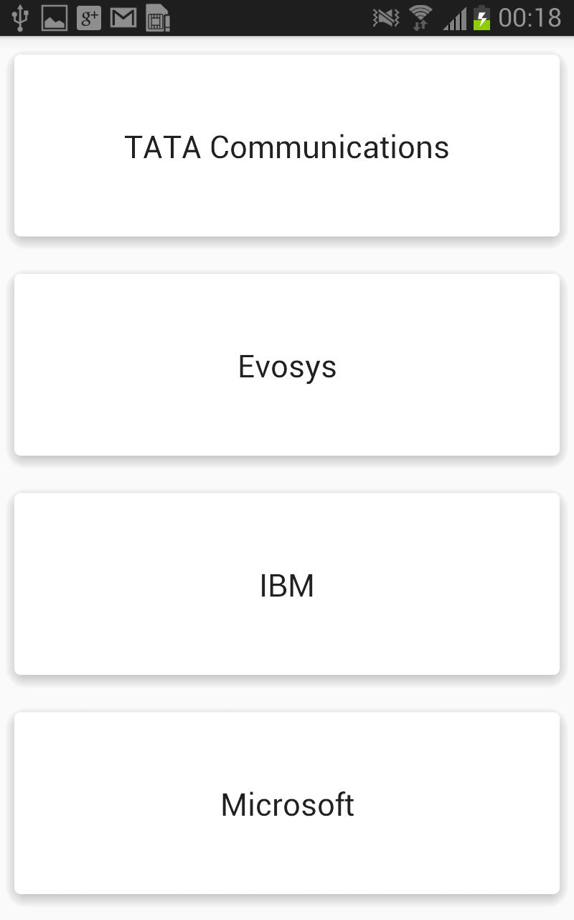
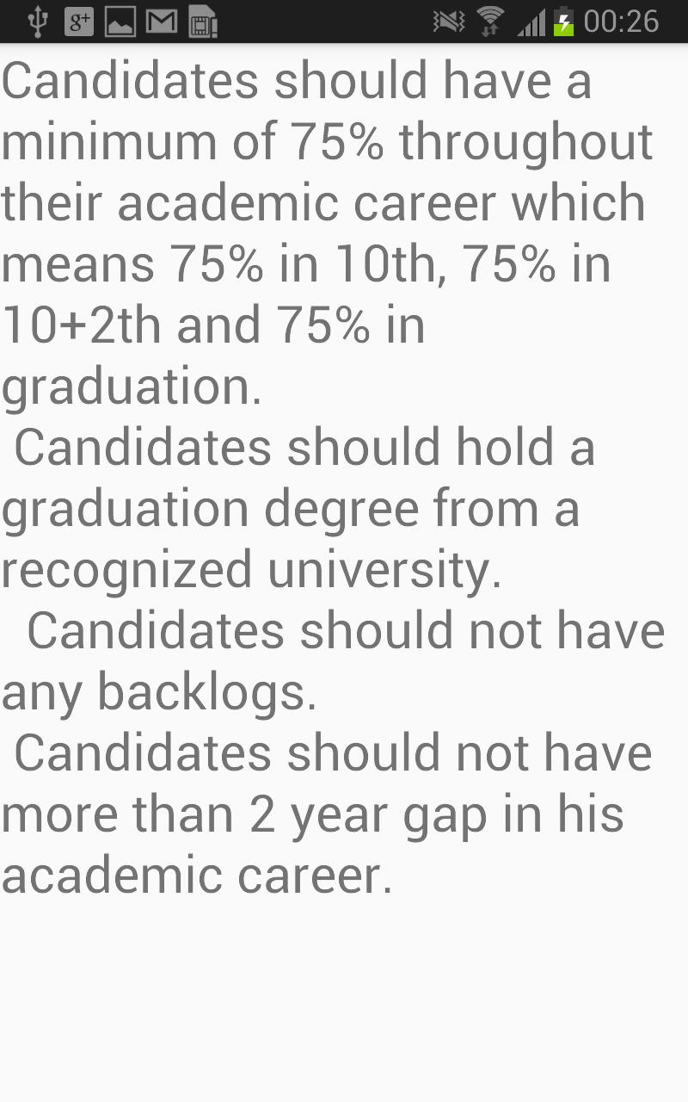
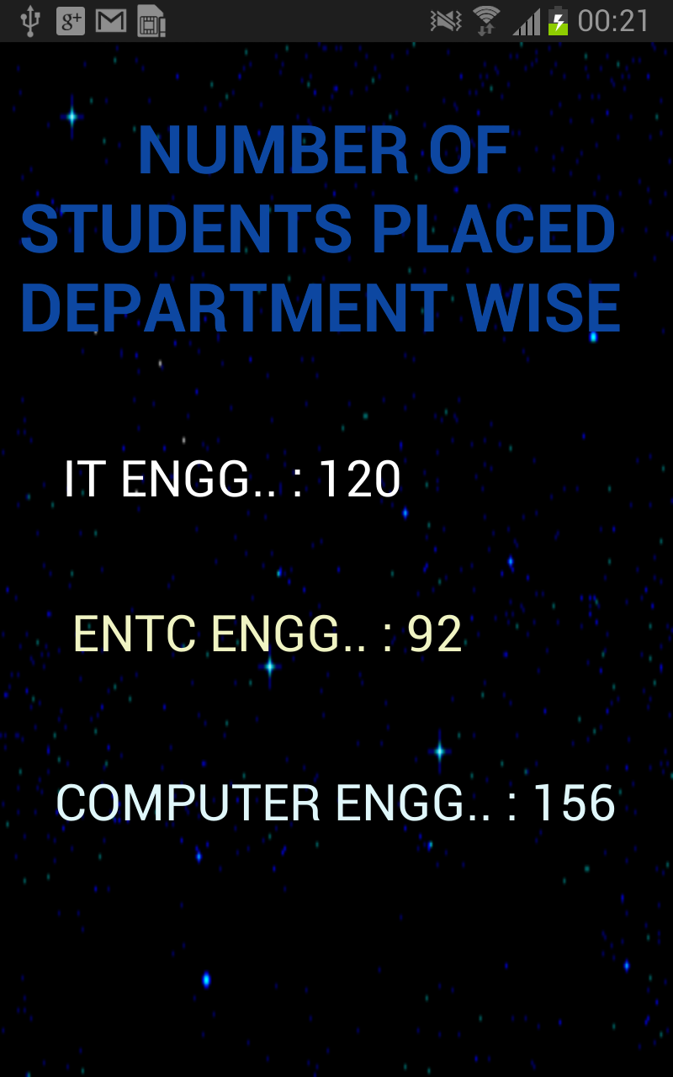
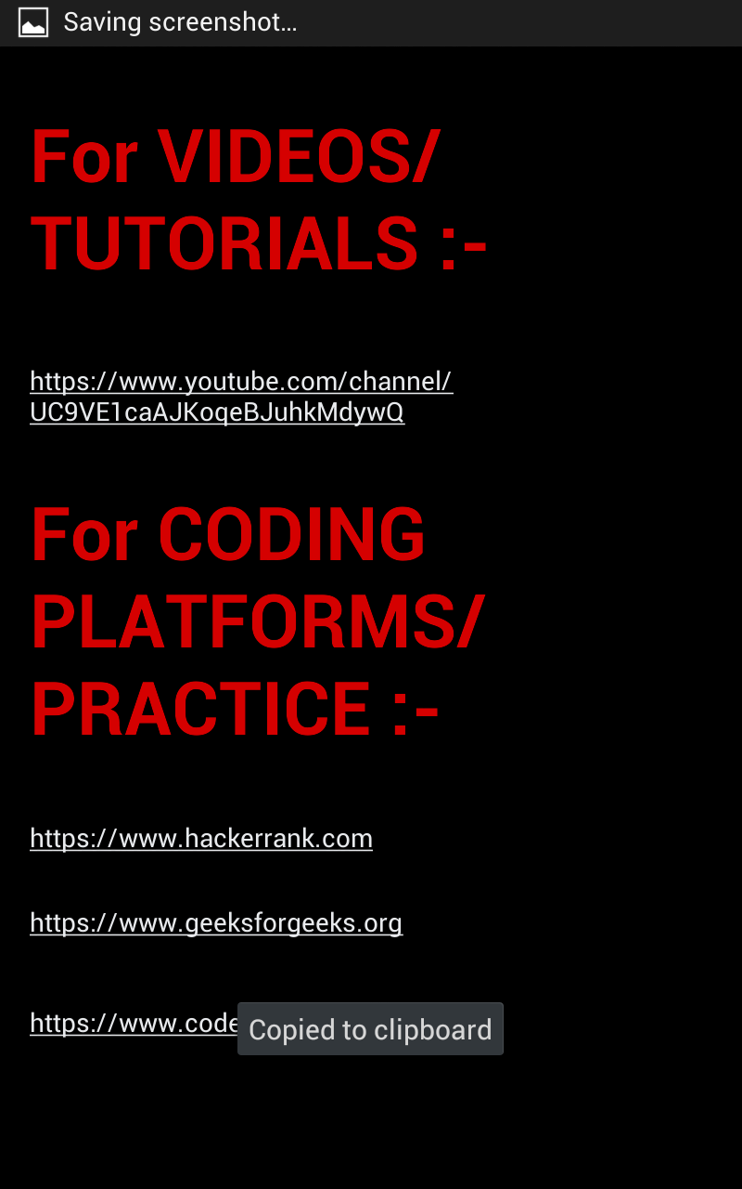
OnClick of any the following buttons :
Companies visiting our college : This event handler takes you to the company activity, where user can view and get updated about the TnP activities or any further information, on clicking their company choice.
Placement Report : Data is usually confidential, but the approximate estimate is shown as to show the placement statistics of the college.
Other References : Freshers can also avail access to an idea of how coding/or some competitive technology is progressing in today’s world. Also, linking from app to webiste is provided for easy connection/direction.

Slide 17
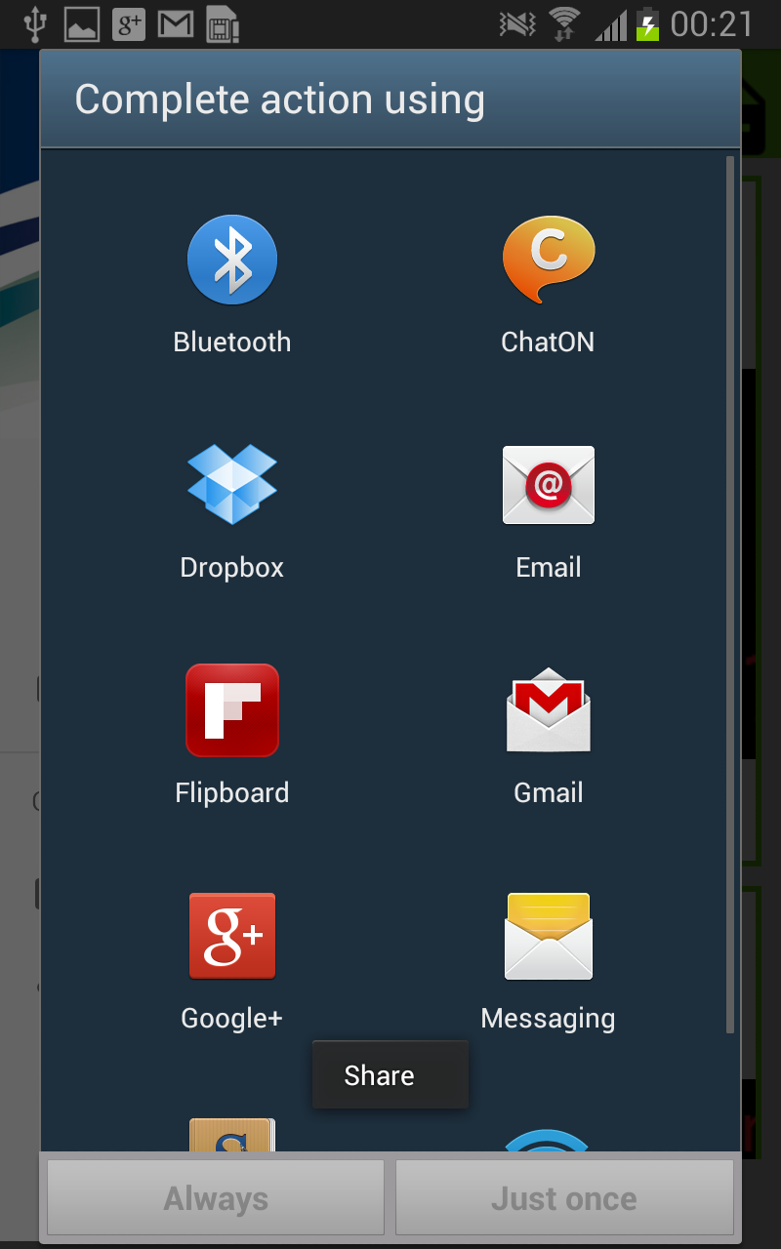
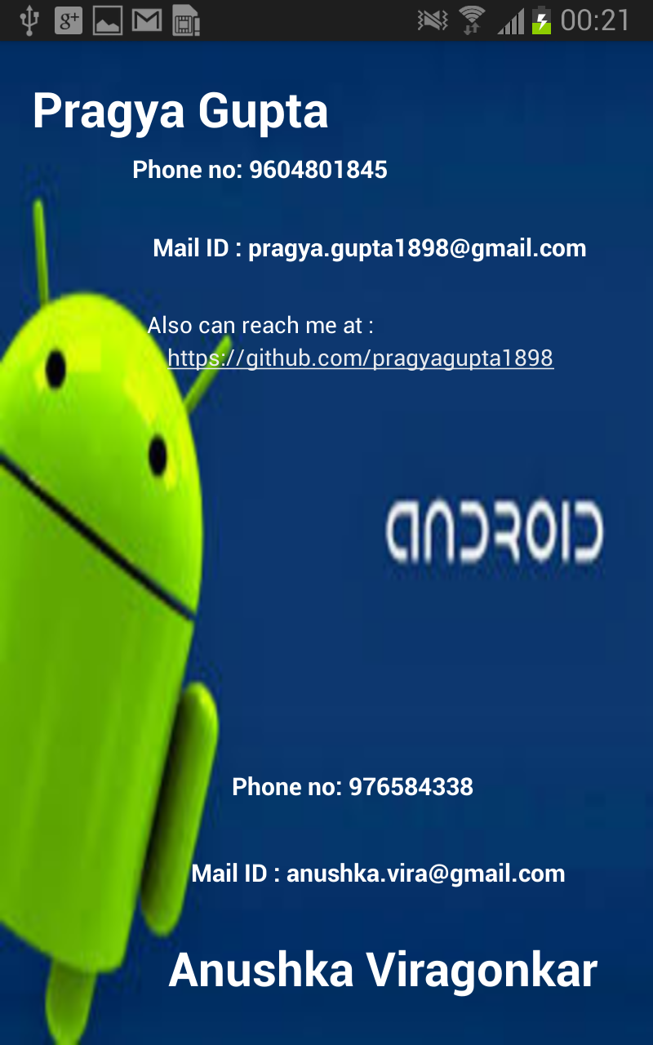
Communication :
Share : Helps in promotion and announcing the better evolution of the app to a wider audience.
Contact Us: If there are any errors/faults found within the app, the user can contact us at our details mentioned.
Logout : This will take the user out of the current account back to the login activity.

Slide 18
CONCLUSION
The Placement app functions as a forum for placement activities, a networking platform for students and helps establish an online community for sharing of information and experience.
It will help people to access information in an orderly, organised and systematic manner, faster and directly through their Android smartphones.

Slide 19
FUTURE SCOPE
Before the development of the project, the prime objective was to keep the hardware & software requirements at a minimum, so that it can function on maximum number of devices. With updates in technology, the app must be able, to be compatible with it.
The project can be made more informative with the help of graphics and making the user interface more user-friendly.
A system can be developed where the posted questions are categorised based on the company name, department etc. So when a user wants to search about posts related to a particular company, all the relevant information would be displayed.
A new feature of bookmarking a discussion can be added. Here, if a user is interested in an ongoing discussion, he will get updates related to the discussion whenever anyone posts something new to the thread. A list of the most bookmarked discussions can be displayed as they are of importance and a majority of people are interested in them.
This app could also play a collaborative role with our college where, the training and placement activities shall be updated under the respective company name, henceforth utilizing this method shall help reduce paper and crowd.

Slide 20

REFERENCES
https://medium.com/@peterekeneeze/build-a-simple-blog-app-with-firebase-in-android-studio-b6482275408
https://www.simplifiedcoding.net
https://www.androidhive.info
https://www.stackoverflow.com
https://developer.android.com

